Slide 1
Personal Creativity Process
10 minutes per day

Slide 2
Contents
Introduction
Intended audience & benefits
Process and Framework
Creative Technique Library
10 * 10 minute exercises – at your own pace
Next Steps
Notes

Slide 3
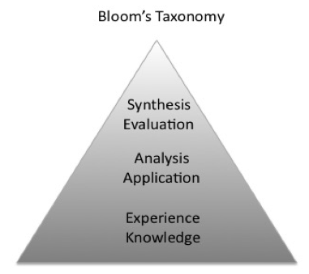
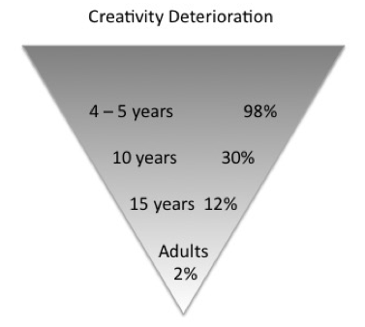
Introduction
Social, Technological, Economic and Political trends show a rising demand for smart-creative people in the information age.
This process, framework and tools can help you reclaim creativity.
Blooms Taxonomy is the teaching
model we were educated by.
Creativity deteriorates over time
(George Land)
It can be argued that creative deterioration
is a by-product of education.
(Sir Ken Robinson)

Slide 4
Intended Audience & Benefits
Anyone wanting to augment their smarts with creative problem solving.
Open minded individuals who have 10 minutes a day for 10 days.
Creative Value = Imaginative Thinking + Judgement + Delivery (Sir Ken Robinson)
What benefits can you expect to achieve in 10 days?
Learn how to quickly find and use 150 imaginative thinking techniques in the library, and know when to apply them.
Apply judgement to know when to proceed, re-iterate or drop ideas before committing to deliver them.
Deliver value to yourself to prove the process. Start small. Never to defeat.
Add the creative problem solving arrow to your quiver of analysis techniques.
Understand the process to: prepare, analyse, deliver and evaluate the impact of creative solutions.
Use FlowTracker app to monitor mind-state changes and boost learning through recency, spacing and interleaving.
Use A3 Thinking Templates
Once mastered at a personal level these techniques can be scaled to team work and strategic problem solving.

Slide 5
Process & Framework
Start in bottom right corner
Follow arrows round frame
Work from outside in
4 internal ’Disney’ personas
Each step has 3 aspects
Grid is creative canvas
Red corners are
potential blocks
To clear blocks adapt
different personas and act AS-IF
Blue line is value path
3 Deliver
Critic
Connection
Resilience
Autonomy
Crowd
Reflection &
Dirt Drive
Absorption
2
Creative
Thinking
4
Value
Creative
Techniques
Library
Impact
Metaphorical
Thinking
Reflection
Creative
Personal
Bias
Other
People
Environment
Child
Start
Here
1 Scan

Slide 6
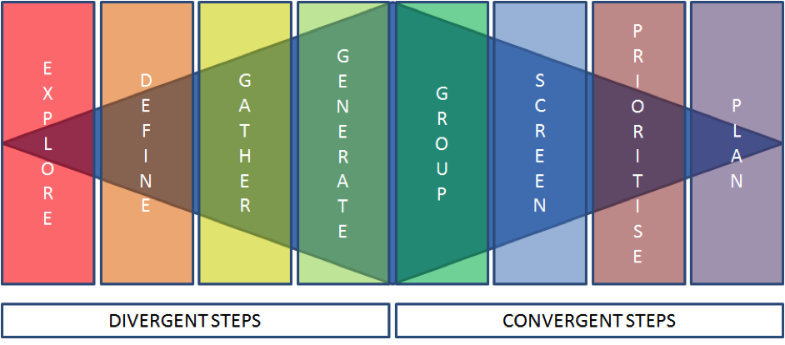
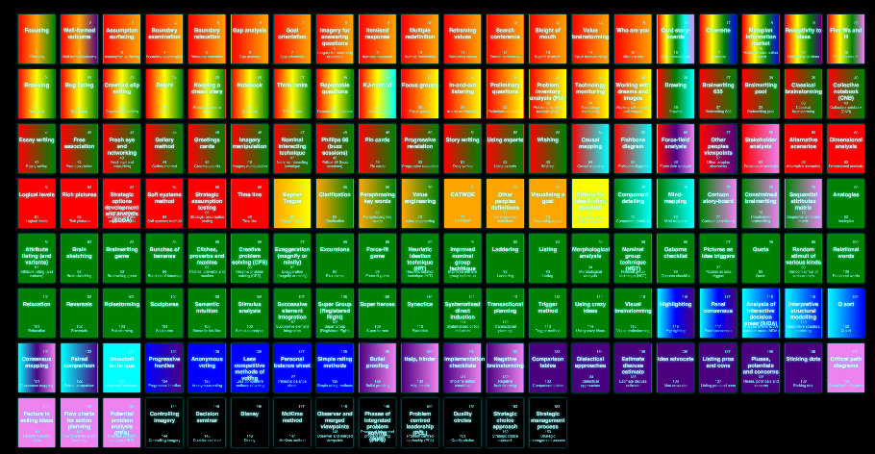
Creative Techniques Library
The creative process can be viewed as a visible spectrum of 8 discrete steps.
The process steps of scan and value can be thought of as infra-red and ultra-violet.
Delivery is your moment in the sun.
The Library is a creativity periodic table.
The exercises will present examples that you can experiment with.
We suggest some initial ones to get started.

Slide 7
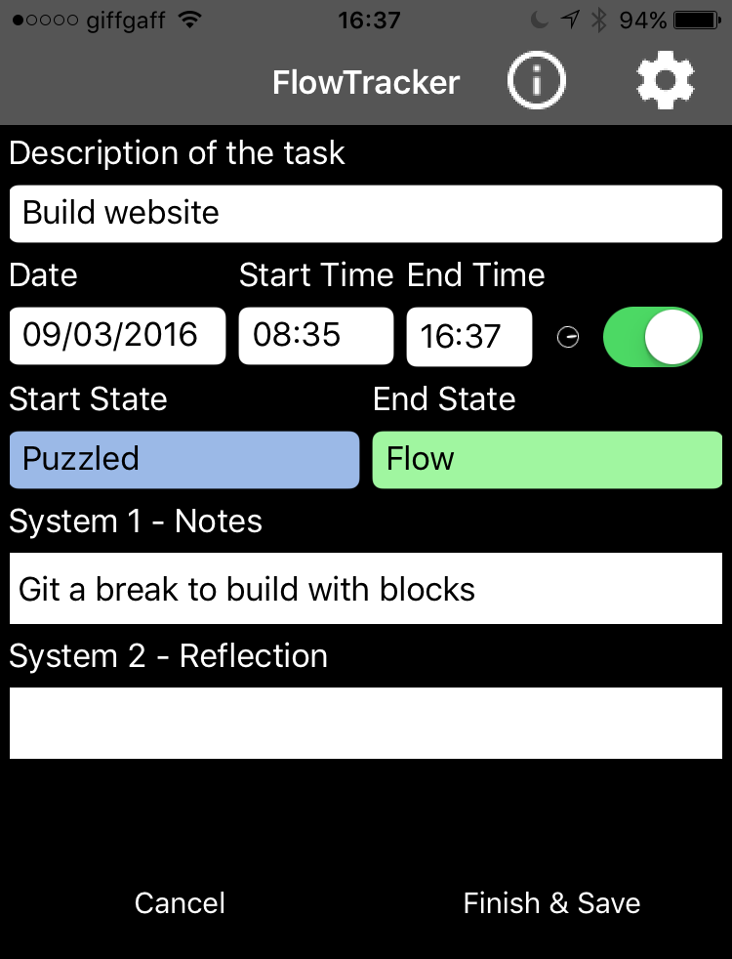
FlowTracker as an aid
Watch the video and download
from FlowTracker.org
Enter task and time details
as per any time recorder
Enter mind-states at start and end
of each task
Enter immediate notes on why mind state changed
Return after a day or two later to enter considered reflection to help store memory in medium and longer term

Slide 8
Exercise Instructions
The following 10 exercises map the steps in the process.
They can be done at your own tempo. 10 days is a suggestion.
On the first iteration consider the potential changes you may need to make to foster creativity.
Fill in the left hand columns in the following sheets to determine if change will be needed.
The answers to the initial questions will form the basis of the actions you need to take to reclaim your creativity.
Make the change on a subsequent iteration. The neuro-plasticity researcher Dr. Norman Doidge says it takes about 5 – 6 weeks to drop current ways of thinking. Time is then needed to embed the new process. This is why we set the second iteration at 10 weeks. It is as fast as we can realistically make it.
2 Reflection sheets are supplied to capture the holistic aspects at the relevant times. It you use the FlowTracker to record reflection you should be able to quickly reflect. Start Small. Never to defeat.

Slide 9
1 Environment
Current Condition
Countermeasures: Next iteration actions
Do you need to change your work-space?
Will you need to work anti-social hours?
Will you work totally alone or with others?
Replace this with your action steps.
There will be time to revisit during reflection and the the implementation stages.
Pains to remove and Gains to be had
Confirmation: What is your definition of done?
Pains
Replace this with outcomes and outputs you consider as finished.
Gains
Follow up: contingency if things don’t work out?
Root Cause Analysis
Can you make do without doing all you planned?
What steps can be taken to carry on or revisit later?
Suggested method:
Nominal Interacting Technique
Feel free to experiment with your own ideas

Slide 10
2 Other People
Current Condition
Countermeasures: Next iteration actions
Who are your crazy-makers?
Are they at work, home, social, hybrid, online?
Replace this with your action steps.
There will be time to revisit during reflection and the the implementation stages.
Vital Conversations to be had
Confirmation: What is your definition of done?
Who What is to be said?
Replace this with outcomes and outputs you consider as finished.
Follow up: contingency if things don’t work out?
Root Cause Analysis
Can you make do without doing all you planned?
What steps can be taken to carry on or revisit later?
Suggested method:
Other Peoples’ Viewpoints
Feel free to experiment with your own ideas

Slide 11
3 Self
Current Condition
Countermeasures: Next iteration actions
What are your biases?
How did you measure them?
Would you do a JoHari to check how others see you?
Replace this with your action steps.
There will be time to revisit during reflection and the the implementation stages.
What changes to correct biases are needed
Confirmation: What is your definition of done?
Attribute Steps to change?
Replace this with outcomes and outputs you consider as finished.
Follow up: contingency if things don’t work out?
Root Cause Analysis
Can you make do without doing all you planned?
What steps can be taken to carry on or revisit later?
Suggested method:
Personal Balance Sheet
Feel free to experiment with your own ideas

Slide 12
4 Metaphorical Thinking
Current Condition
Countermeasures: Next iteration actions
Lack of metaphor mashing
What is your company like? machine, theatre, brain,
sewer, orchestra, jazz group, brain, network, garden,
forest, zoo.
Replace this with your action steps.
There will be time to revisit during reflection and the the implementation stages.
What practice can be done
Confirmation: What is your definition of done?
Do it privately to prevent fear of ridicule.
Write Haikus to get small wins quickly.
Replace this with outcomes and outputs you consider as finished.
Follow up: contingency if things don’t work out?
Root Cause Analysis
Can you make do without doing all you planned?
What steps can be taken to carry on or revisit later?
Suggested method:
KJ Method
Feel free to experiment with your own ideas

Slide 13
5 Divergent Convergent Thinking
Current Condition
Countermeasures: Next iteration actions
Analysis is abstract, linear and does not invoke
visceral interaction with the subject.
No passion, reduced interest, Cerebral EDF
Replace this with your action steps.
There will be time to revisit during reflection and the the implementation stages.
What practice can be done
Confirmation: What is your definition of done?
Learn the techniques in the library to a surface level.
Be able to call up the relevant through the screen.
Stay tuned as the library evolves
Replace this with outcomes and outputs you consider as finished.
Follow up: contingency if things don’t work out?
Root Cause Analysis
Can you make do without doing all you planned?
What steps can be taken to carry on or revisit later?
Suggested method:
JFDI
Feel free to experiment with your own ideas

Slide 14
6 Reflection & Dirt Drive
Background
Plan Details
Halfway through – preparation done
1 – Connection: 10 minute exercise
2 – Resilience: 10 minute exercise
3 - Autonomy: 10 minute exercise
Current Condition
Need a small exercise to work through next 3 days
and assess value afterwards
Proposal
Unresolved Issues
Create Haikus that reflect the differences between:
Connecting to self vs. self analysis
Resilience vs. Other People
Autonomy vs. People Pleasing
Is there anything that you need to discuss?
Use the Forums to get answers to your questions.
Implementation Schedule
Alternatives
Specify when you can find 10 minutes to get into FLOW and do your work for each exercise.
Draw cartoons to show the differences
Create a card story board to show the differences
Parody a song to show differences
Mix and match or create/select your own techniques

Slide 16
7 Connection
Current Condition
Countermeasures: Next iteration actions
This is about connecting to your creative self.
It is why the process is iterative and can be carried
out on the value line as the environment is set
and techniques are being learned.
Replace this with your action steps.
There will be time to revisit during reflection and the the implementation stages.
What practice can be done
Confirmation: What is your definition of done?
Use the creativity values and maxims on yourself
Replace this with outcomes and outputs you consider as finished.
Follow up: contingency if things don’t work out?
Root Cause Analysis
Can you make do without doing all you planned?
What steps can be taken to carry on or revisit later?
Suggested method:
Practice the maxims in the small
Feel free to experiment with your own ideas

Slide 17
8 Resilience
Current Condition
Countermeasures: Next iteration actions
Reinforce your new found autonomy while being
as caring and diplomatic as possible.
Replace this with your action steps.
There will be time to revisit during reflection and the the implementation stages.
What practice can be done
Confirmation: What is your definition of done?
Consider what the outcomes will be for you by
developing some extra resilience.
The brain and body interact in ways that can make
shifting negative emotion difficult (Van Der Kolk)
Replace this with outcomes and outputs you consider as finished.
Follow up: contingency if things don’t work out?
Root Cause Analysis
Can you make do without doing all you planned?
What steps can be taken to carry on or revisit later?
Suggested method:
Love your self
Feel free to experiment with your own ideas

Slide 18
9 Autonomy
Current Condition
Countermeasures: Next iteration actions
You are too much of a people pleaser
Learn to put your own needs first, within reason.
Replace this with your action steps.
There will be time to revisit during reflection and the the implementation stages.
What practice can be done
Confirmation: What is your definition of done?
Draw from the conversations you intend having with
other people and the changes you may want to make
to you own biases.
Replace this with outcomes and outputs you consider as finished.
Follow up: contingency if things don’t work out?
Root Cause Analysis
Can you make do without doing all you planned?
What steps can be taken to carry on or revisit later?
Suggested method:
Personal CATWOE
Feel free to experiment with your own ideas

Slide 19
10 Absorption
Current Condition
Countermeasures: Next iteration actions
This is how you perceive the outputs and outcomes
from last weeks work
Outputs may be more quantifiably easy to measure
while outcome are qualitative
Replace this with your action steps.
There will be time to revisit during reflection and the the implementation stages.
What practice can be done
Confirmation: What is your definition of done?
Look at things from different internal perspectives.
Critic
Parent
Child
Replace this with outcomes and outputs you consider as finished.
Follow up: contingency if things don’t work out?
Root Cause Analysis
Can you make do without doing all you planned?
What steps can be taken to carry on or revisit later?
Suggested method:
Disney Method
Feel free to experiment with your own ideas

Slide 20
11 Impact
Current Condition
Countermeasures: Next iteration actions
Visualise the outcome of the changes that you
will make when you complete the next loop through
the process.
Replace this with your action steps.
There will be time to revisit during reflection and the the implementation stages.
What practice can be done
Confirmation: What is your definition of done?
Controlling Imagery
Replace this with outcomes and outputs you consider as finished.
Follow up: contingency if things don’t work out?
Root Cause Analysis
Can you make do without doing all you planned?
What steps can be taken to carry on or revisit later?
Suggested method:
See above
Feel free to experiment with your own ideas

Slide 21
12 Reflection Report
Background
Results
Current Condition
Confirmation:
Filled in personas
Worked through exercises
Have material for second pass

Slide 22
Next Steps
Using the completed sheets you can work through them to make the changes.
We estimate it will take about 10 weeks. Of course you may be faster or slower.

Slide 23
Notes
Values and Maxims
References & Bibliography
A3 Templates.
Contact Details

Slide 24
Values and Maxims
Curiosity, Forgiveness, Love, Sense of direction
Adapt a set to break a set
Explore the givens
Broad picture, local detail
Value play
Build up, don’t knock down
Love with looseness
Its there nurture it
Involve others
Connect and be receptive
Know what you really want
Cycle often, close late
Manage the process
Pause and consider reflect and move
Be enterprising to boldly go
First release is the worst, not a fail!
Serially and Seriously curious
Value play but be sceptical
Build up, don’t knock down
Live with looseness
Its there nurture it
Involve others
Connect and be receptive
Broad Picture, local detail
Cycle often, close late
Manage the process
And have Plan B in reserve

Slide 25
The dichotomies of creativity
Singular vs. Collective
Step changes akin to state changes
Classical vs QED
blah

Slide 26
Template A3 Reports
The exercise slides are A3 Thinking examples. Here are templates you can use.
A3 Problem solving
A3 Proposal
A3 Status Report
Note: For the Problem solving in the exercises we assumed the Background was the
same: “Learning Creative Problem Solving”. the following template is in full.

Slide 27
A3 Problem Solving
Background
Countermeasures
Current Condition
Goals
Confirmation: What is your definition of done?
Follow up: contingency if things don’t work out?
Root Cause Analysis

Slide 28
A3 Proposal
Background
Plan Details
Current Condition
Proposal
Unresolved Issues
Implementation Schedule
Alternatives

Slide 29
A3 Status Report
Background
Results
Current Condition
Confirmation: What is your definition of done?

Slide 30
Persona Template

Slide 31
Can I use this at work?
The short answer is of course
Team Working
Strategy
Climate
Creative Analysis
Confident experimentation
Trustimates
Satisfying work
Team added-value analysis
Objective customer value
Scanning trends
Fast option identification
Innovation Metrics
Realistic change timescales
Improved morale
Improved Maturity Models
Better Bottom Line

Slide 32
Contact Details
Website: http://timeandemotion.com
email: zak@timeandemotion.com
FB: ti

